Slide 1
Global review of induced and triggered earthquakes
Miles P. Wilson
Gillian R. Foulger, Jon G. Gluyas, Richard J. Davies & Bruce R. Julian
British Seismology Meeting
5^{th-}7th April 2017

Slide 2
Contents
Disclaimer and terminology
Study background
HiQuake overview
Injection-induced earthquakes
Society and induced earthquakes
Summary

Slide 3
Disclaimer
Years | Education
2011-2014 | B.Sc. (Hons.) Geophysics with Geology (Durham University, UK)
2014-2015 | M.Sc. (Distinction) Petroleum Geoscience (Heriot-Watt University, UK)
2015-2016 | Research Assistant (ReFINE and Professor Gillian Foulger)
2016- | Ph.D. Applied hydrogeological modelling (Durham University, UK)
Not a seismologist
‘Big picture science’

Slide 4
Terminology
‘Induced’ vs. ‘Triggered’ earthquakes
Induced
Released energy predominantly of anthropogenic origin
Triggered
Released energy predominantly of natural origin
Induced – Anthropogenic influence

Slide 5
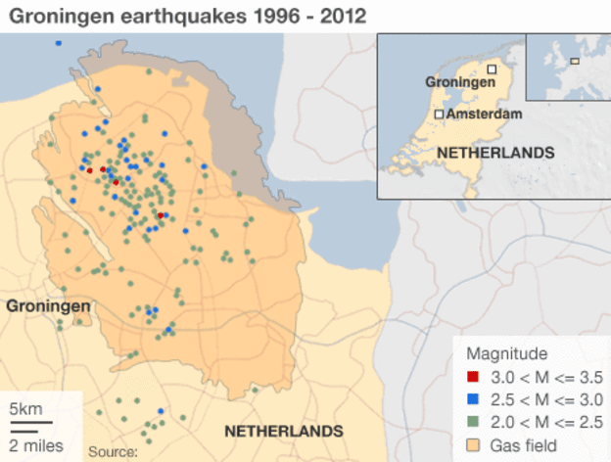
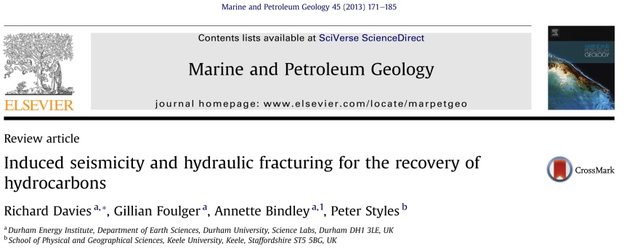
Study background
Groningen gas field, The Netherlands
Production from 1963
2.8 tcm gas in place
~50% natural gas production in the Netherlands
Induced earthquakes
Maximum observed magnitude
M_{L} 3.4 (16/08/2012)
Update the 2013 database
http://www.bbc.co.uk/news/world-europe-22542982

Slide 6
Study background
Mmax Workshop for NAM
March 2016
Database and website release
January 2017
Project start
February 2016
AGU presentation
December 2016
Literature review, predominantly peer-reviewed studies
Report all suggested cases (not our opinion)

Slide 7
HiQuake overview
www.inducedearthquakes.org

Slide 8
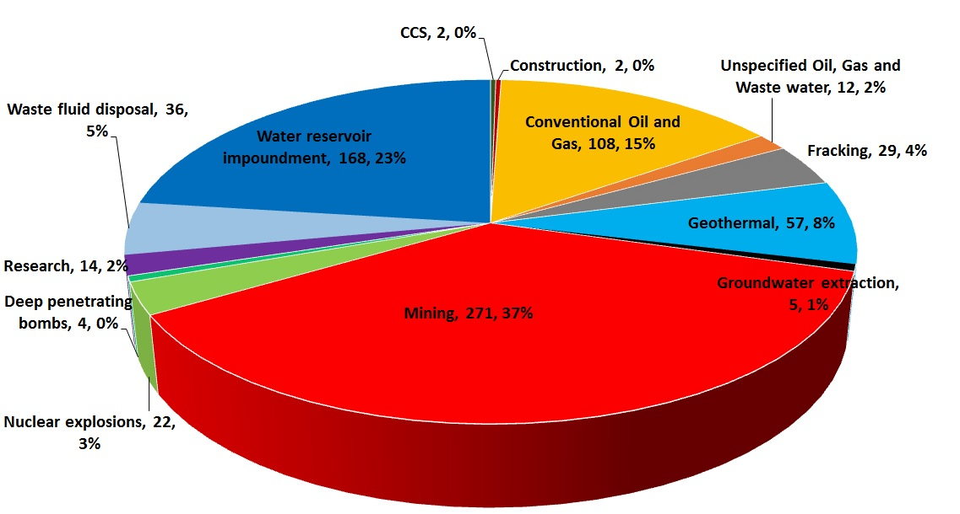
Project types
730 projects with reported induced seismicity

Slide 9
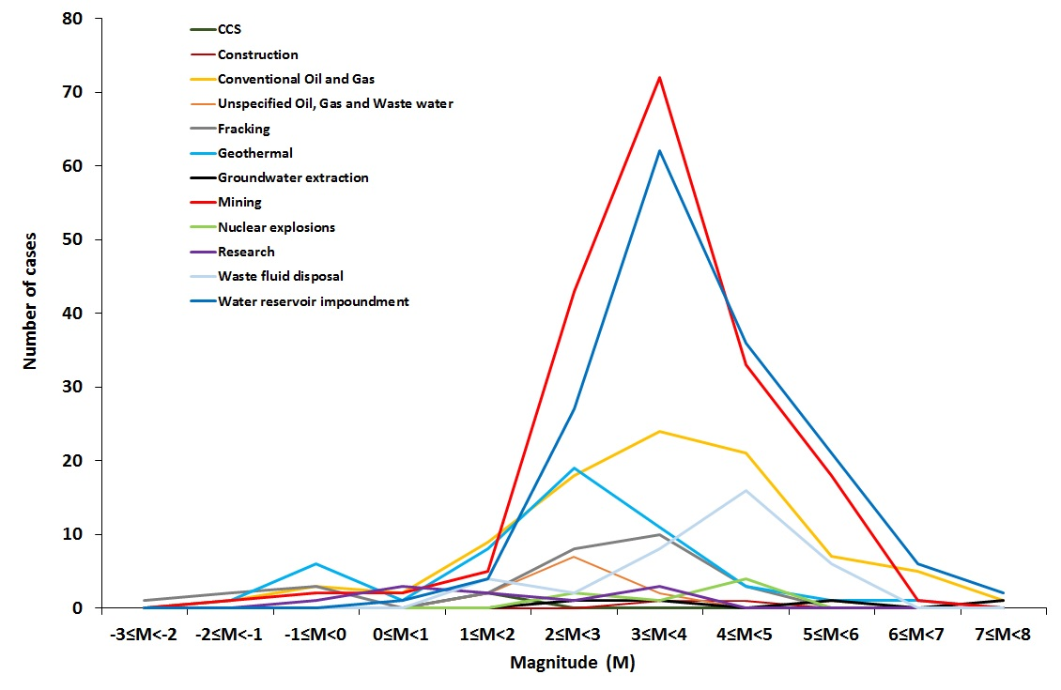
Mmax range
Most commonly reported Mmax value 3≤M<4

Slide 10
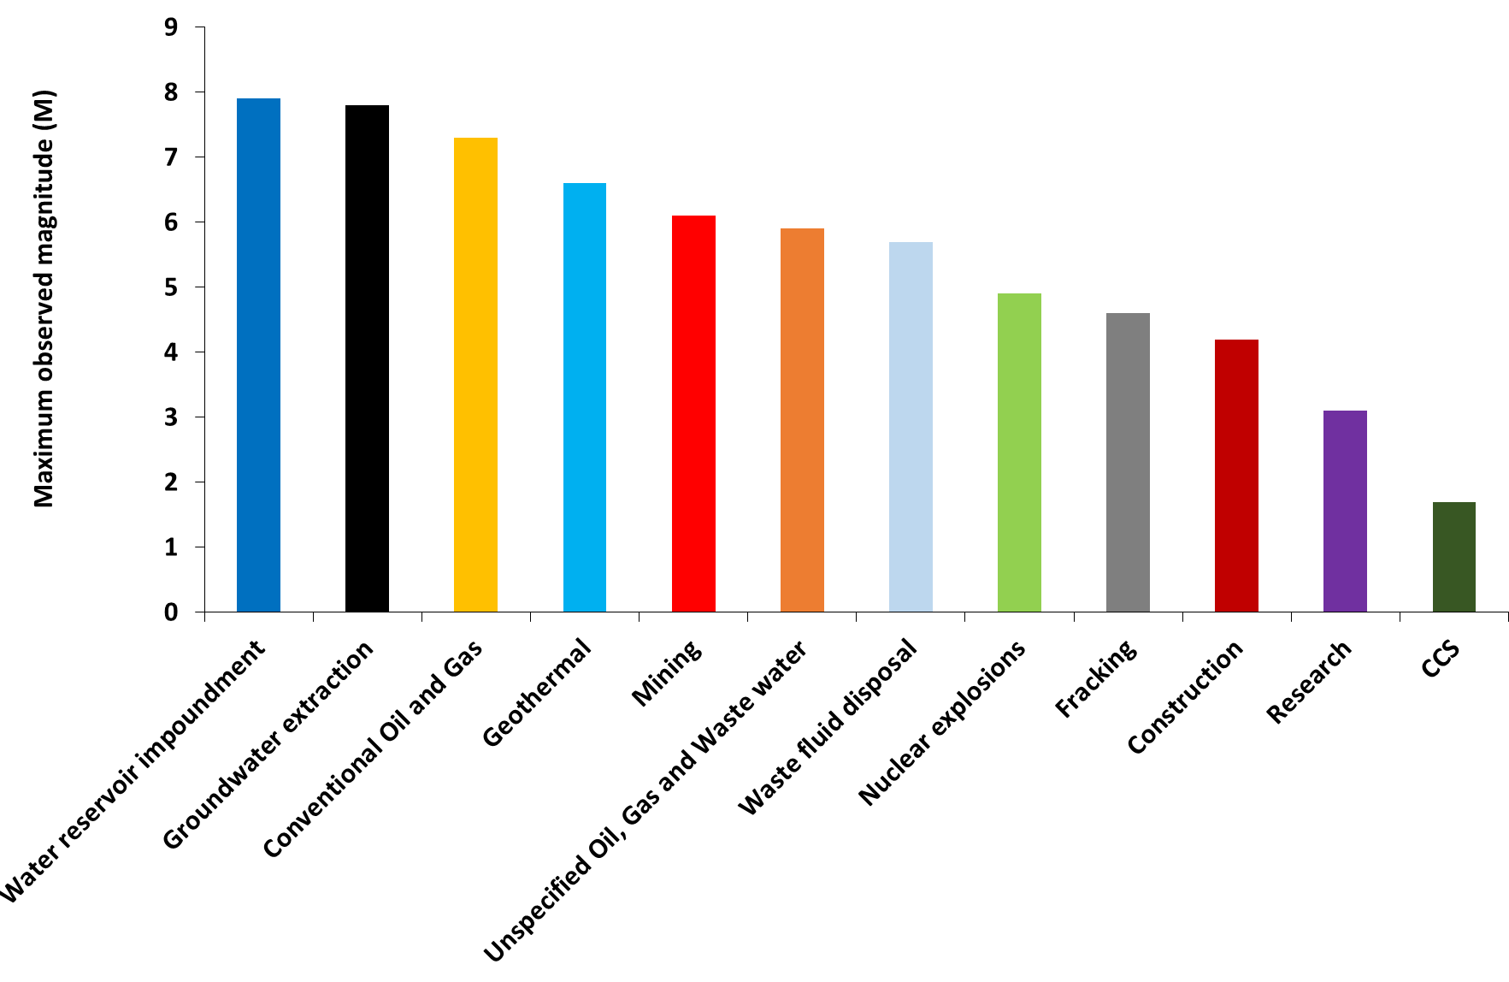
Maximum Mmax’s for different project types
Gorkha earthquake, Nepal
Zipingpu Dam, China
Gazli, Uzbekistan
Cerro Prieto, Mexico
Bachatsky, Russia
Emilia sequence, Italy
Pawnee, USA
Cannikin Bomb, USA
Pink Mountain, Canada
Folkestone, UK
Rangely, USA
In Salah, Algeria

Slide 11
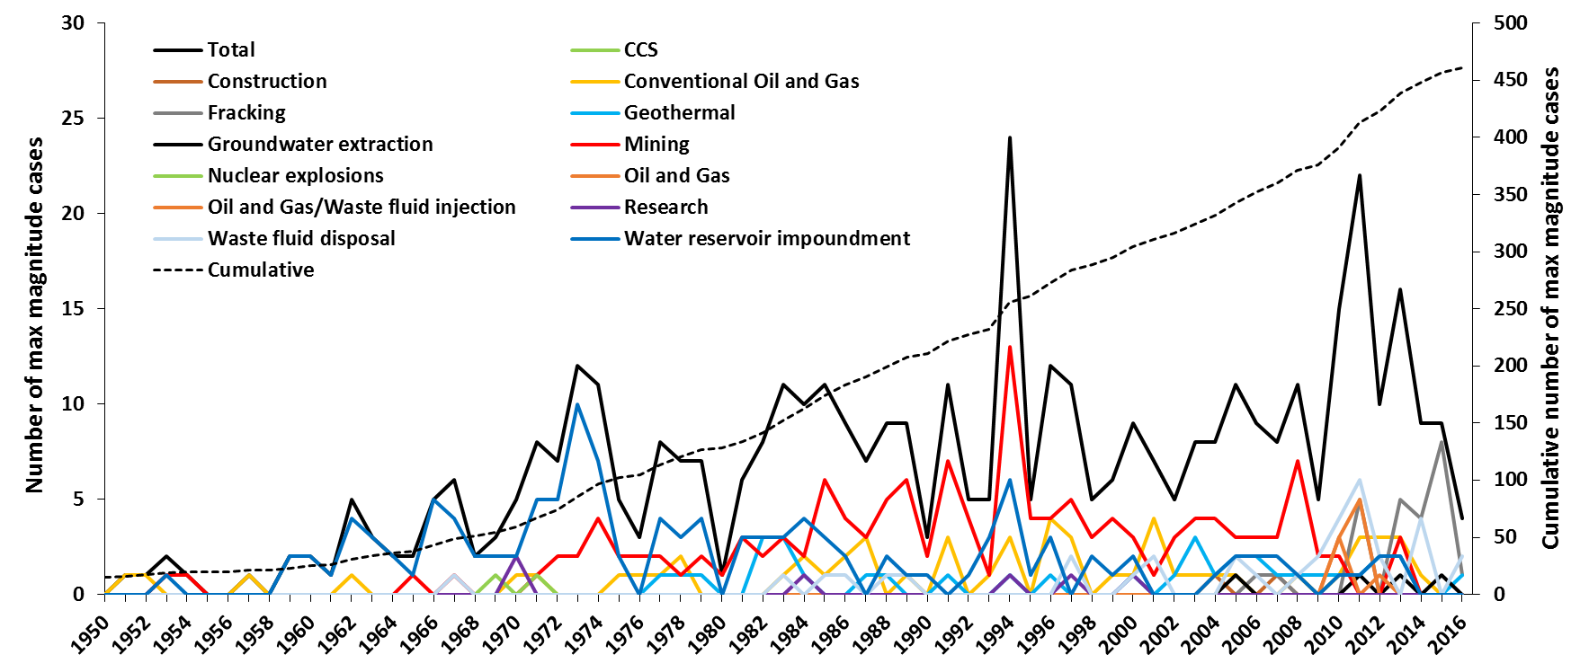
Induced earthquakes through time

Slide 12
Induced earthquakes through time

Slide 13
Induced earthquakes through time

Slide 14
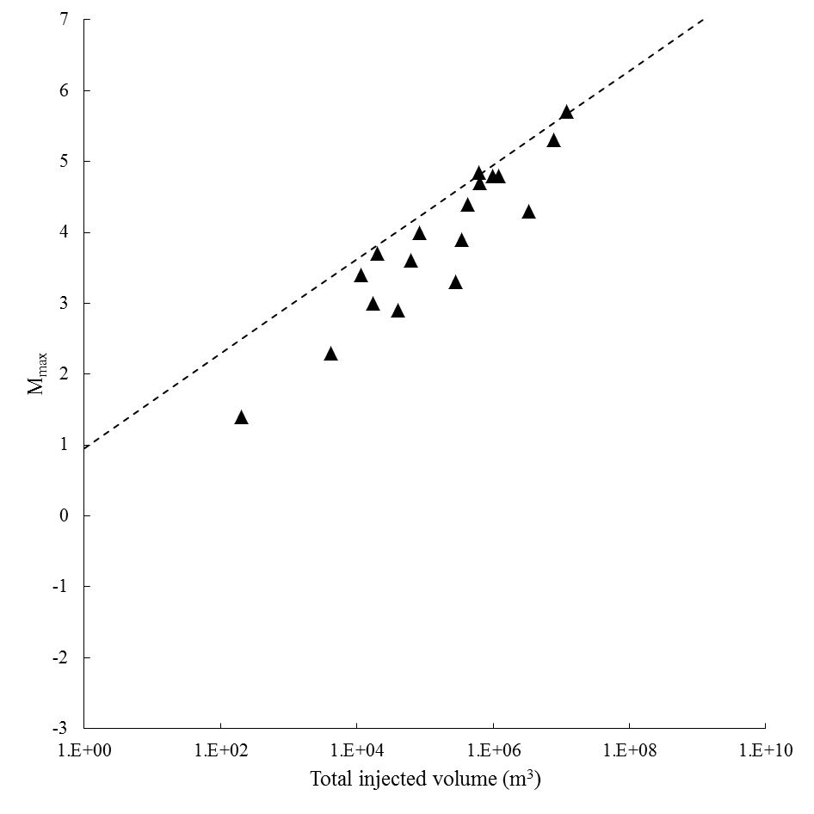
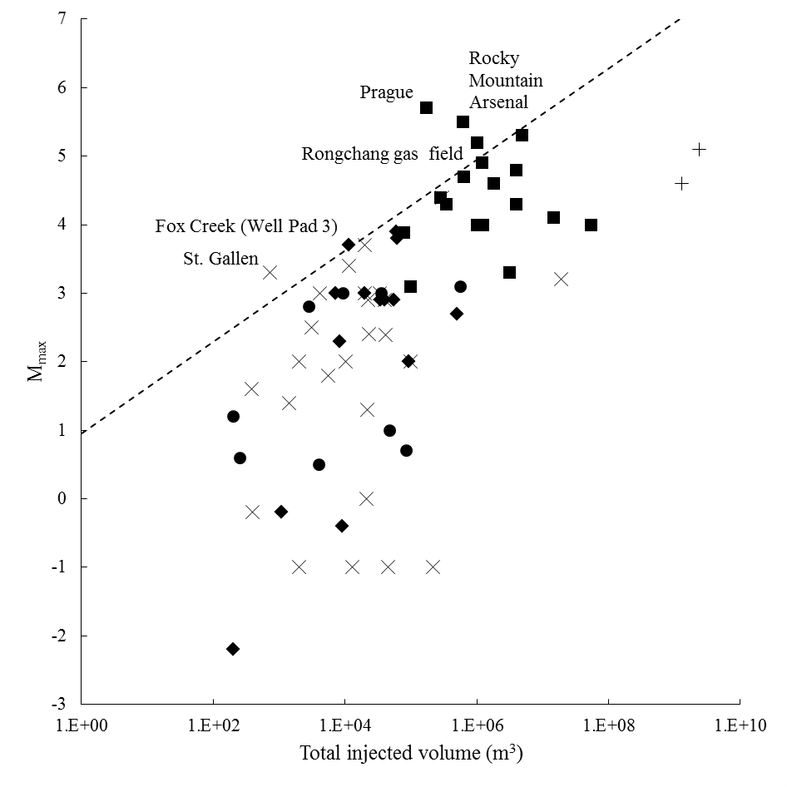
Injection-induced earthquakes
McGarr (2014)
Anthropogenic control on Mmax?

Slide 15
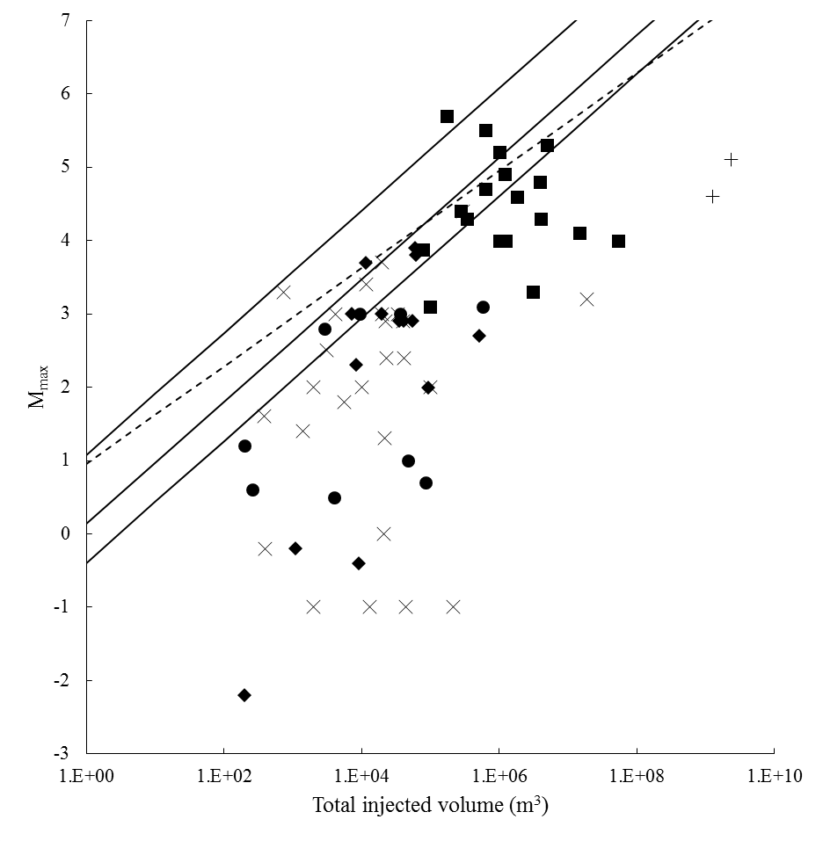
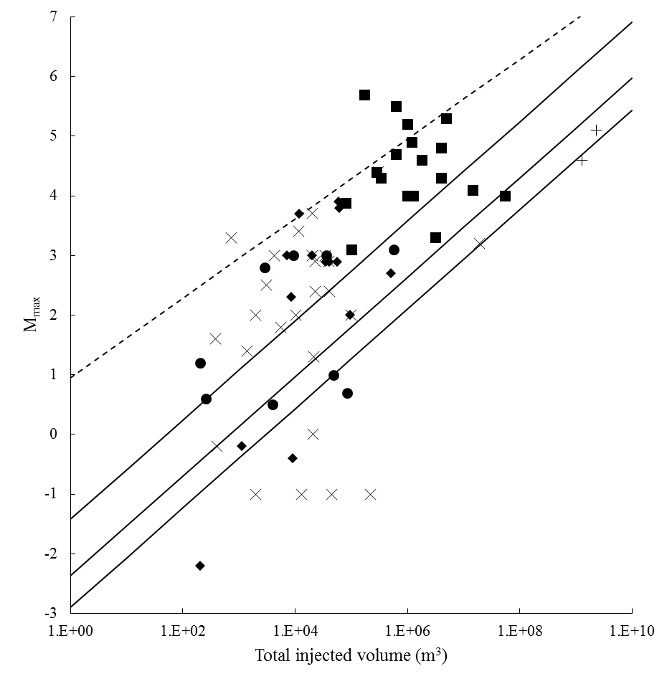
Injection-induced earthquakes
95%
50%
5%
95%
50%
5%
van der Elst et al. (2016)
b = 1.2
Ʃ = 0
b = 1.2
Ʃ = -3
Tectonic control on Mmax?

Slide 16
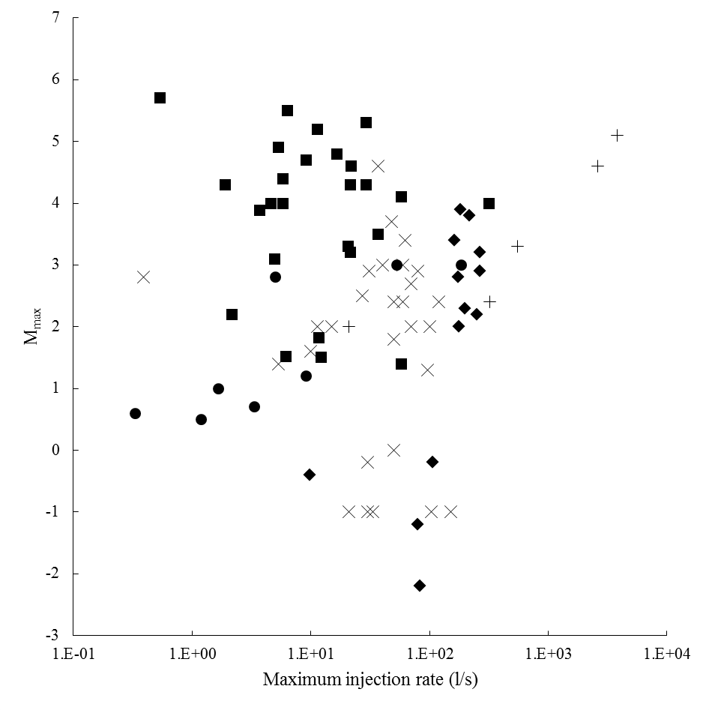
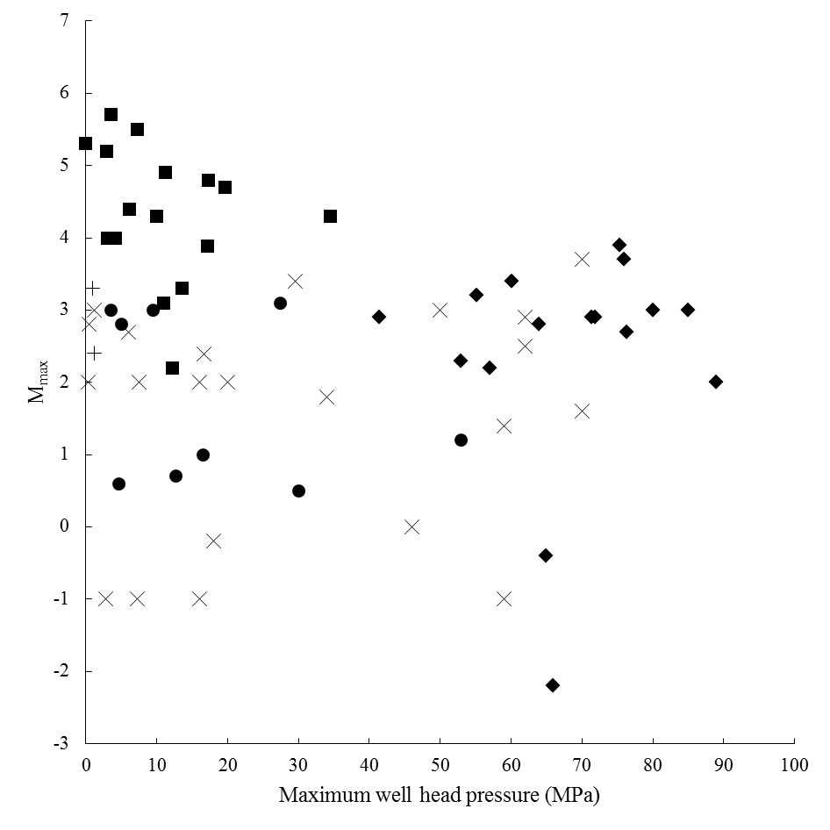
Injection-induced earthquakes
Tectonic or anthropogenic control on Mmax?

Slide 17
Injection-induced earthquakes
?
Anthropogenic or tectonic control on Mmax?

Slide 18
Society and induced earthquakes
M_{L} 1.5 smallest felt fracking-induced earthquake (BGS, 2016)
M_{W} 4.6 in Canada not felt (Atkinson et al., 2016)
Earthquake magnitudes
(and peak ground accelerations)
require context

Slide 19
Society and induced earthquakes
We don’t want induced earthquakes to be a risk…
But we all use electricity, metals, plastics, petrol, etc.
Seismic
Risk
Resource Demand

Slide 20
Summary
Induced earthquakes caused by more industrial activities than generally appreciated
HiQuake contains 730 projects, largest proposed induced earthquake has M_{W} 7.9
Recent years have seen an increase in reported injection-induced earthquakes
Anthropogenic or tectonic control on Mmax still uncertain
Earthquake magnitudes need consideration in societal context
Balance needed between resource demand and seismic risk

Slide 21
Thank you
www.inducedearthquakes.org
miles.wilson@durham.ac.uk

Slide 22
References
Atkinson, G. M., Eaton, D. W., Ghofrani, H., Walker, D., Cheadle, B., Schultz, R., Shcherbakov, R., Tiampo, K., Gu, J., and Harrington, R. M. (2016). Hydraulic Fracturing and Seismicity in the Western Canada Sedimentary Basin. Seismological Research Letters, 87(3), 631-647.
British Geological Survey (BGS). (2016). Blackpool earthquake, magnitude 1.5, 27 May 2011. http://earthquakes.bgs.ac.uk/research/events/BlackpoolMay2011.html. Retrieved 28.11.16.
McGarr, A. 2014. Maximum magnitude earthquakes induced by fluid injection. Journal of Geophysical Research: Solid Earth, 119(2), 1008-1019.
van der Elst, N. J., Page, M. T., Weiser, D. A., Goebel, T. H., & Hosseini, S. M. (2016). Induced earthquake magnitudes are as large as (statistically) expected. Journal of Geophysical Research: Solid Earth, 121(6), 4575-4590.

