Slide 1
The Swedish National Seismic Network: Hazard assessment in a low-seismicity intraplate area
Roland Roberts and many others¹
University of Uppsala
Sweden
¹ including Björn Lund, Reynir Bödvarsson, Oli Gudmundsson, Ari Tryggvason, Hossein Shomali, Peter Schmidt, PhD students, support personnel….

Slide 2
Sweden: Part of the Fennoscandian shield
Ancient shield area, ”built up” by tectonic collisions from the ”south”
Major mineral resources
Repeated glaciation → little or no sedimentary cover
”Norway” (not part of the Shield) joined Sweden ”recently” (400Ma)
Far from any major, active plate boundary
Ongoing movement NW of ”Sweden” relative to ”Denmark”, from M4 focal mechanisms in the Tornquist zone.
Current GPS-measurable movement is from glacial isostatic adjustment only, up to about 1cm/yr vertical + resulting (a few mm/yr) horizontal movement. No other sig movement resolvable

Slide 3
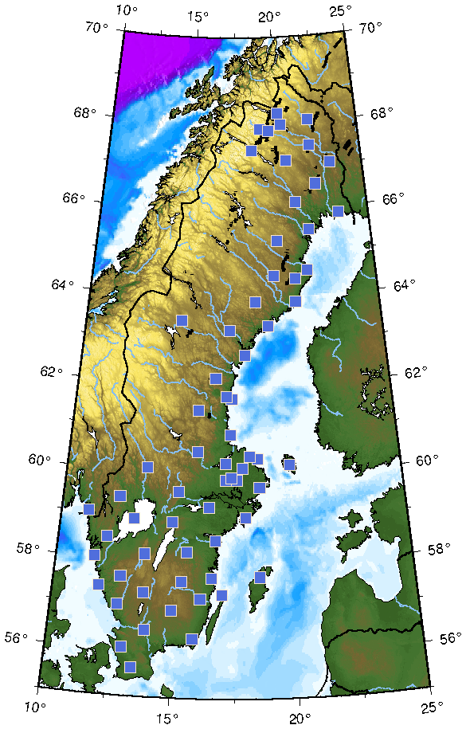
The Swedish National Seismic Network (SNSN)
65 permanent broadband stations
Average station spacing about 70km
Magnitude of completeness, M0.4 or so within the network.
All stations on-line to Uppsala University
Total staff 7-8 (not only running the network)
Similar system to Iceland
Financing: Partly State. Partly industry.

Slide 4
The SNSN – Some technical details
Sensors. Mostly Guralp with very high gain (+/- 10,000 V/m/s)
Deployment – find place remote from roads, houses etc
But with electricity within less than a km
Computer at electricity
Vault on bedrock 1-2 metres below surface and 0.3-1 km from computer (optical fibre + power)
Also temporary deployments (months, years) stand-alone. Logistically difficult (e.g. no road for 20 km)

Slide 5
Sweden = Very stable area Why a large seismic network?
Basic research
Large earthquakes do occur (M5.4 in 1904)
Nuclear monitoring (previously polticially very important – then less relevant – but more relevant again…)
Mining seismicity

Slide 6
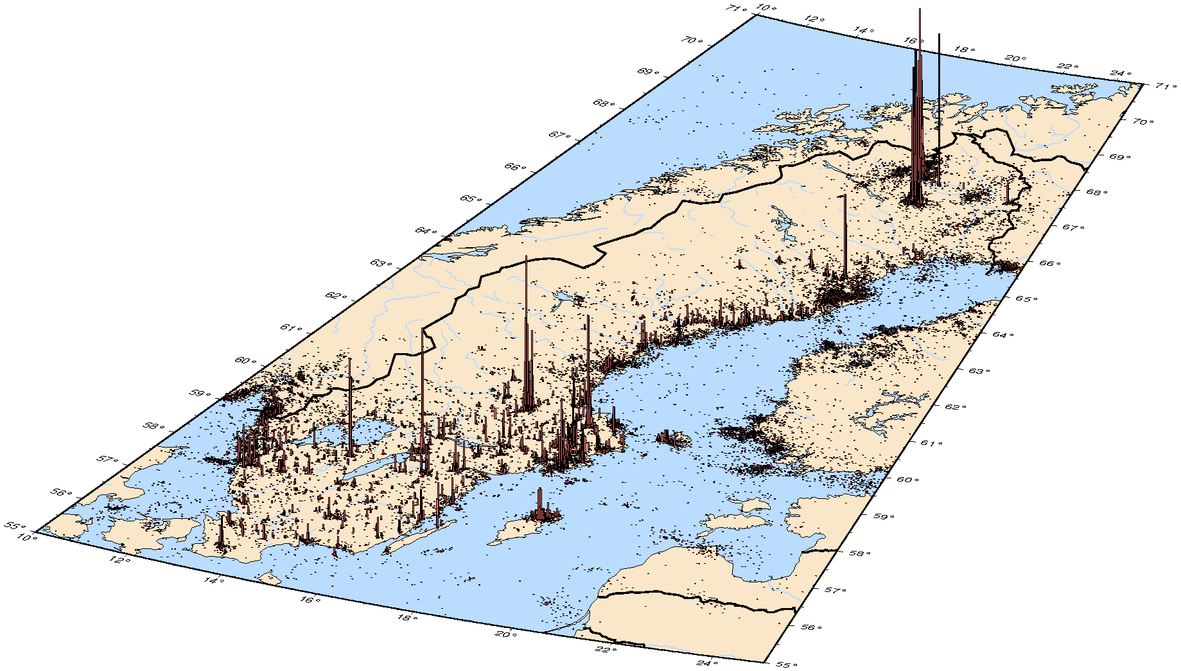
What do we record?
- Earthquakes
- Blasts:
quarries
construction work
mines
military (Navy)
- Induced quakes,
rock bursts and
rock fall in the mines.

Slide 7
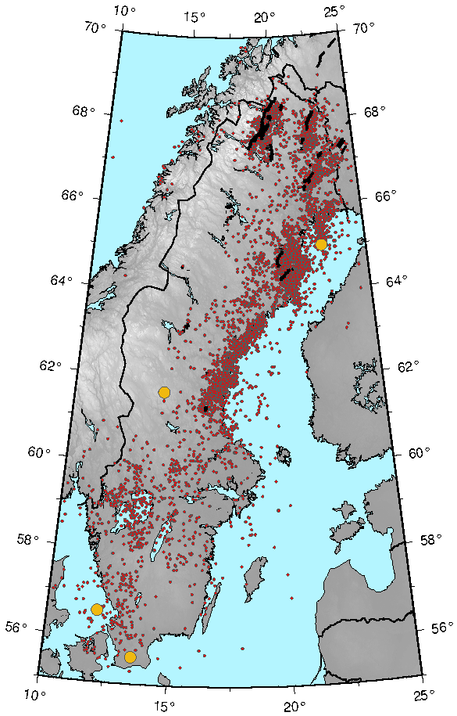
Swedish seismicity
SNSN data 2000-2017
~ 8,100 events.
Yellow: M4+
Seismicity is low – approx average rate, one M4 / decade
Isolated larger events sometimes observed (little or no aftershocks or foreshocks)
Even in entire catalogue - very few aftershocks (anomalously so). Only 5-10% of catalogue aftershocks [Can assessed robustly from e.g. waiting time distributions, as well as by identifying individual aftershocks]

Slide 8
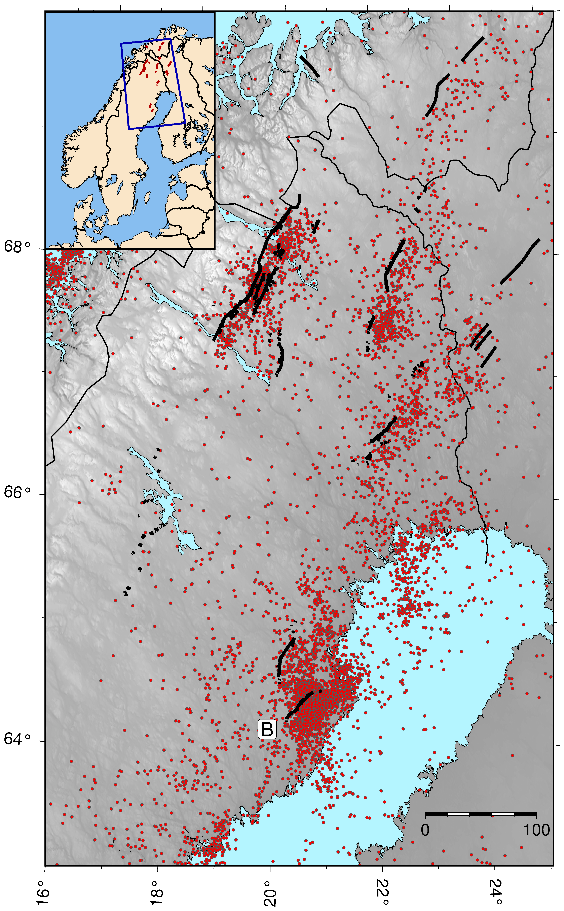
Swedish seismicity Neotectonic movements
Dots: earthquakes Black lines: Neo-tectonic faults
Several large faults (up to 160km long, with throw of 10m) moved about 10 000 yrs ago → events up to M8+
It is not known if such events can occur in an inter-glacial period
A
A. Pärvie fault
B. Burträsk fault

Slide 9
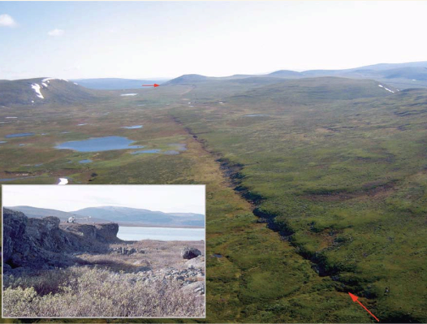
Swedish seismicity Neotectonic movements
Dots: earthquakes Black lines: Neo-tectonic faults
Several large faults (up to 160km long, with throw of 10m) moved about 10 000 yrs ago → events up to M8+
It is not known if such events can occur in an inter-glacial period
71% of all events north of 66°N in Sweden occur between 30 km SE and 10 km NW of a postglacial fault. (Lindblom et al., 2015)
A
A. Pärvie fault
B. Burträsk fault

Slide 10
Hazard in a low seismicity area is low. So, who cares?
Large neotectonic faults, some (?) still active.
Some at major topographic features (scarps).
Many large dams in Sweden, usually earth dams
A large event here (<<M8) could be devastating
Essentially no general earthquake building codes.
Eurocode 8 not translated by authorities.
Recent ice age → recent topography, often ”unstable” (steep slopes, quick clays). Some evidence (mostly Norway) for earthquake simulated landslides
The nuclear industry must consider seismic risk

Slide 11
How can you assess hazard in an area which has very low seismicity, but has had ”recent” very large earthquakes?
Apply standard probabilistic (PSHA) approaches?
Define an area with including a ”sufficient” number of events
Maybe decluster (but very few aftershocks in Fennoscandia)
Generate G-R curves. Get a and b values
Estimate Mmax (max plausible earthquake)
Do the statistics (interpolate, extrapolate…)
→ Hazard estimate, usually probablistic PGA (peak ground acceleration) over a given period

Slide 12
”Standard” hazard assessement (PSHA) in Fennoscandia
Is this done?
Yes

Slide 13
”Standard” hazard assessement (PSHA) in Fennoscandia
Is this done?
Yes
Does it work well?
No

Slide 14
”Standard” hazard assessement (PSHA) in Fennoscandia
Is this done?
Yes
Does it work well?
No
Does it work at all?
Quite possibly not, beyond saying obvious things like ”hazard is low” (which we already know)
Why so negative?

Slide 15
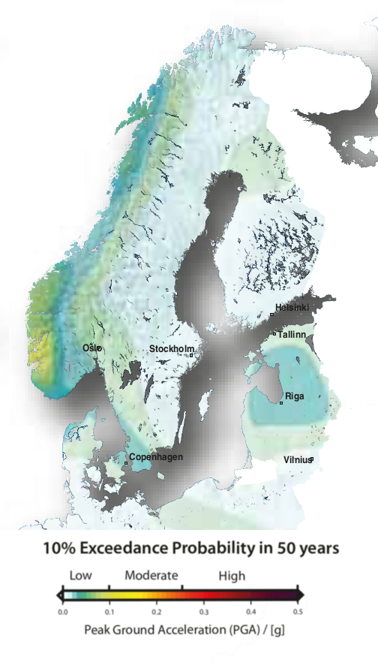
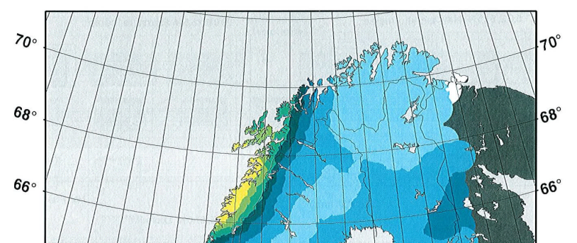
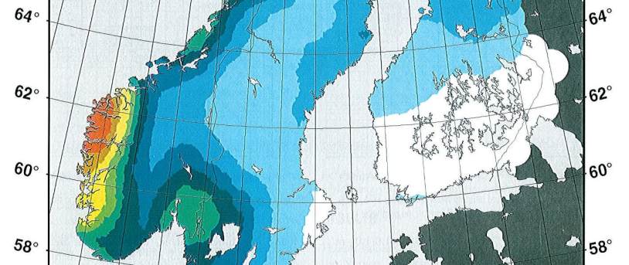
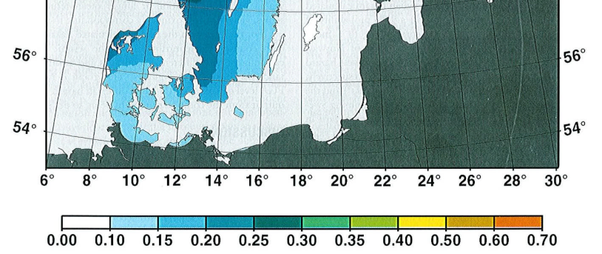
Two ”recent” hazard assessments: Significantly different results due to choice of data and details of methodology
Wahlström & Grünthal (2001)
SHARE (2013)
1904 M5.4
m/s^2

Slide 16
Some of the problems with hazard assessment in Fennoscandia
PGA may not be the best measure of hazard, due to seismicity and attenuation. E.g. CAV (cumulative absolute velocity) may be better
Low seismicity → even with low magnitude of completeness, large areas must be used to get a reasonable number of events for the GR (1000s sq km). Uniformity of behaviour over such an area?
We should not assume temporal stationarity (later)
Mmax estimates are very important. How reliable are these?

Slide 17
Mmax: Maximum ”plausible” earthquake
”Mechanical” assessment for Fennoscandia → very large (shield=strong)
Statistical approach based on G-R
GR ”saturates” → ”down turn” in curve at large M → modified GR curve (gamma)
→ assume this shape, fit to data → Mmax → Much lower estimates than the mechanical assessment
This is probably not a sensible approach: The concept is assumption dependent, usesd discrete, sparse, data and an assumed continous distribution → easily seriously misleading, if you are not very careful
Statistically derived Mmax estimates are, at least in low-seismicity areas, almost certainly misleading, and potentially dangerously so.

Slide 18
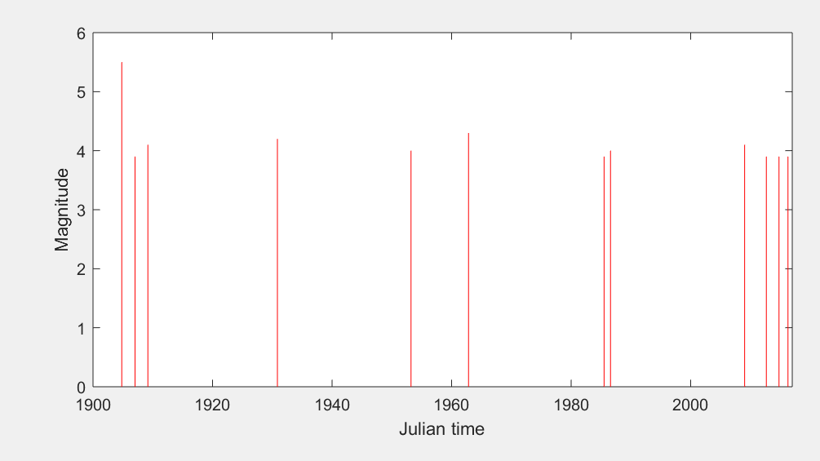
Temporal variations in seismicity
Apart from aftershocks (and perhaps foreshocks) most hazard assessment assumes a statistically stationary situation
Is seismicity in Fennoscandia temporally stationary?
We observe very clear temporal clustering → → → → →
Assume events statistically independent → 99%+ probability that the these event clusters are (mechanically) related
Magnitude of all 3.9+ events since 1900

Slide 19
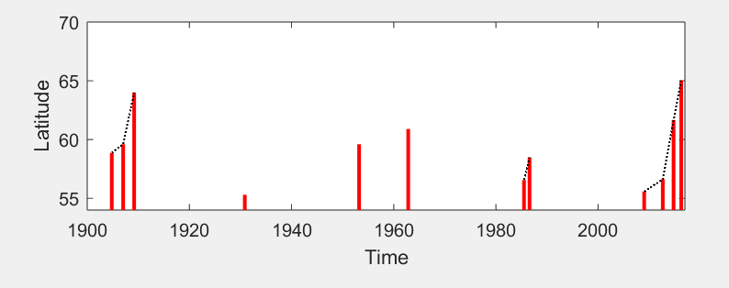
Spatio-temporal patterns
seismicity:
Event Latitude vs time (date) for all M3.9+ events
Very clear spatio-temporal pattern (also confirmed by other data, not shown)
Events shown: Fault length ≈1km
→ Tiny compared to the 100’s km event separations
Recall also the earlier comment about few fore- and aftershocks → it seems that ”isolated” larger events may occur in otherwise seismically ”silent” areas. If so, using time-varying PSHA will not help

Slide 20
Some conclusions (1) (not all new)
Seismic risk in Fennoscandia is low, but not negligible.
Different (new) hazard assessment strategies than in other areas are necessary
Low seismicity → very sensitive seismic networks necessary
Very rare but ”high-impact” events probably statistically dominate hazard → ”relating to” hazard is difficult, even conceptually
Standard hazard assessment methods are clearly misleading

Slide 21
Some conclusions (2)
Seismicity is strongly episodic, and seens to show remarkable long-range tempo-spatial patterns, which cannot be explained by e.g. coulomb stress transfer between events
To deal with the hazard issue, we must first try to understand the stress-transfer mechanisms…..
Until we understand this, should probably work with risk scenarios based on simplistic hazard estimates, rather than trying to get the hazard estimates ”correct”

Slide 22
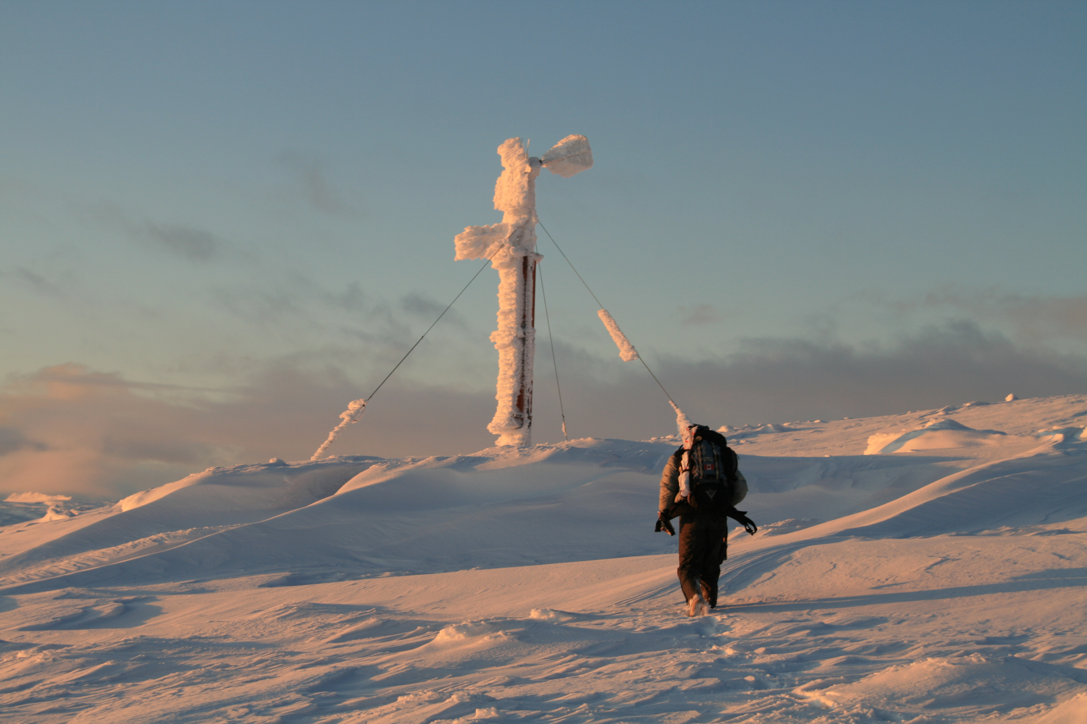
We also do really nice ski trips.
Thanks!

