Slide 1
A short-term time-dependent seismicity model for mega-thrust subduction earthquake sequences
Lizhong Zhang
Dr. Maximilian Werner
Dr. Katsu Goda

Slide 2
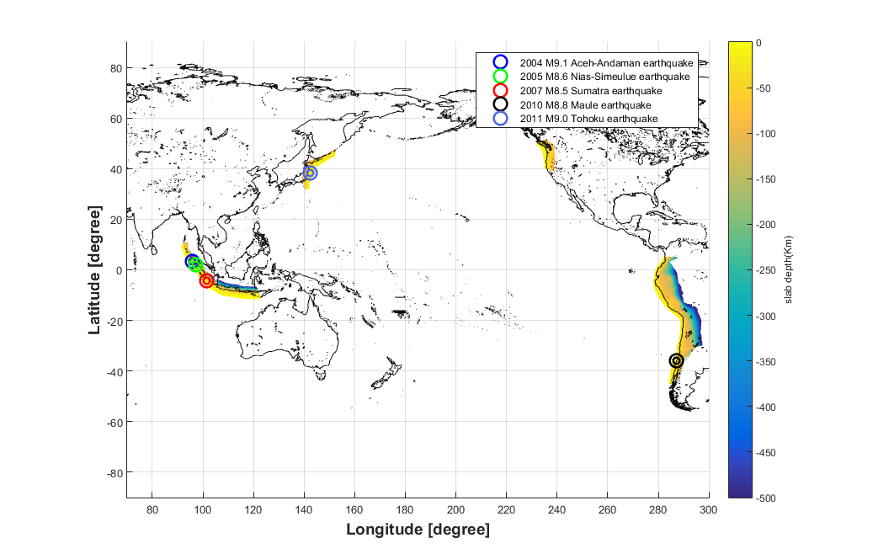
Global megathrust subduction earthquakes M≥8.5 since 2004
2011 M 9.0
2004 M 9.1
2005 M 8.6
2007 M 8.5
2010 M 8.8

Slide 3
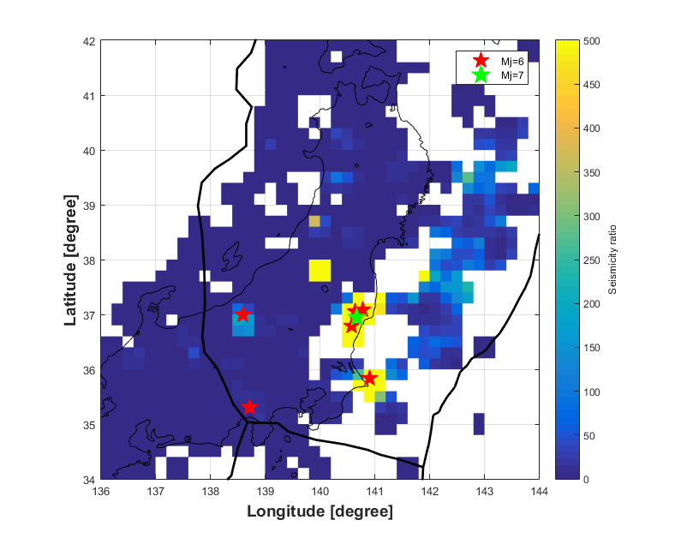
Mj 7 Iwaki earthquake was triggered in the overriding plate on 11th of April
Crustal seismicity ratios (M>0 and depth<20km) between 3-month pre-mainshock (2010.12.08-2011.03.08) and 3-month post-mainshock (2011.03.09-2011.06.09). Pentagons in red and green are the triggered shallow crustal earthquakes with Mj=6 and Mj=7, respectively.

Slide 4
Global megathrust subduction earthquakes M≥8.5 since 2004
Objective
To access the triggering abilities of global megathrust subduction earthquakes (M ≥8.5) on continental crusts with seismicity (M≥5) in space and time.
2011 M 9.0
Cascadia Subduction zone
2004 M 9.1
2005 M 8.6
2007 M 8.5
2010 M 8.8

Slide 5
Epidemic-Type Aftershock Sequence (ETAS) model
Conditional intensity function:
$λ\left(t,x,y | H_{t}\right)= μ\left(x,y\right)+ \sum_{j:t_{j}<t}{g(t−t_{j},x−x_{j},y−y_{j};M_{j})} (1)$
Triggering function:
$g\left(t,x,y;M\right)= K_{0} e^{α\left(M−M_{cut}\right)}$
$·c^{p−1}(t+c)^{−p}\left(p−1\right)$ (2)
$·{\left(d e^{γ\left(M−M_{cut}\right)}\right)}^{q−1}\frac{\left(q−1\right)}{π{\left(x^{2}+y^{2}+d e^{γ\left(M−M_{cut}\right)}\right)}^{−q}}$
Parameter estimations
Maximum likelihood estimation (MLE) approach with quasi-Newton method
$lnL(θ)=\sum_{i=1}^{n}{\log\left(λ\left(t_{i},x_{i},y_{i} | H_{t_{i}}\right)\right)−\int_{s}^{ }{\int_{0}^{T}{λ\left(t,x,y\right)dt dx dy (3)}}}$
Productivity
Temporal distribution
Spatial distribution

Slide 6
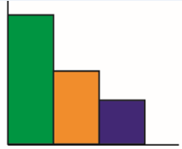
The ETAS aftershock simulations
2) Assign magnitudes
1) Estimate the number of triggered aftershocks
Mainshock
Magnitude distribution
5) 2nd, 3rd … generation of aftershocks
3) Re-sample time
4) Assign locations
Temporal distribution

Slide 7
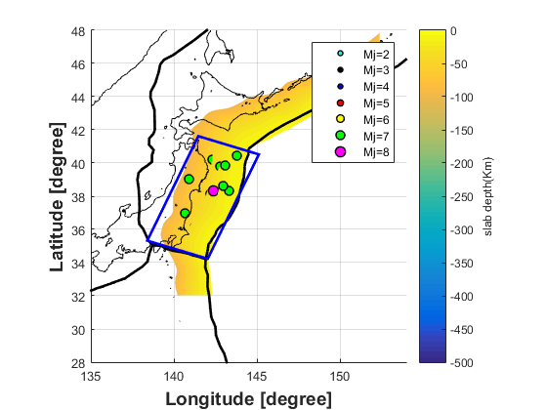
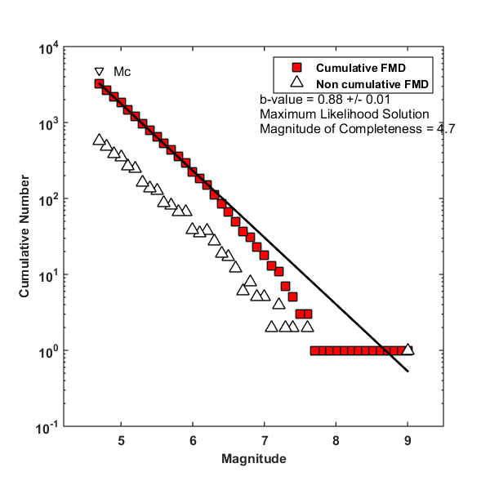
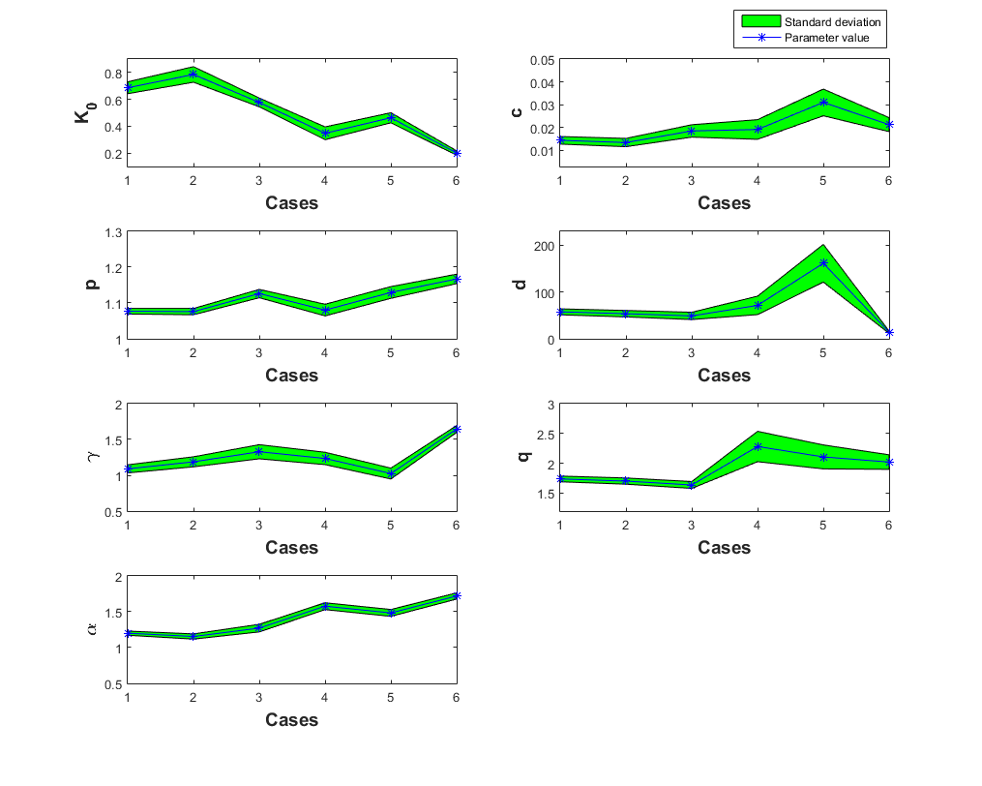
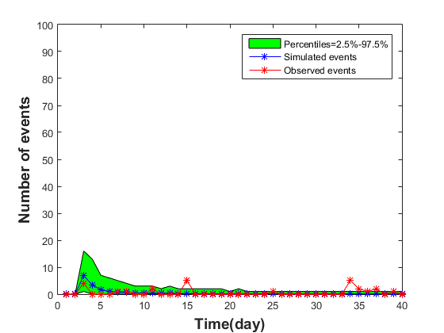
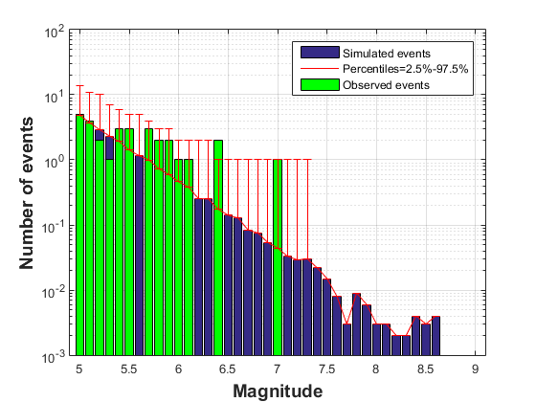
Procedures to implement the ETAS model
Select complete earthquake catalogues with time, epicentres, and magnitudes
b-value check
Mc check
Parameter estimations
MLE approach
The ETAS aftershock simulations

Slide 8
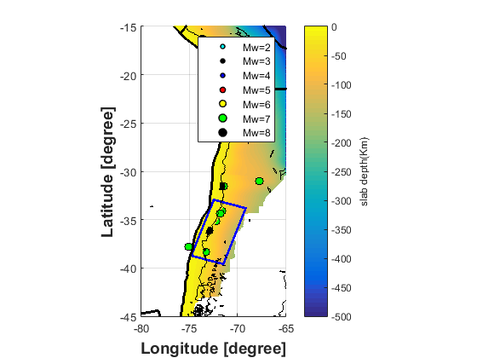
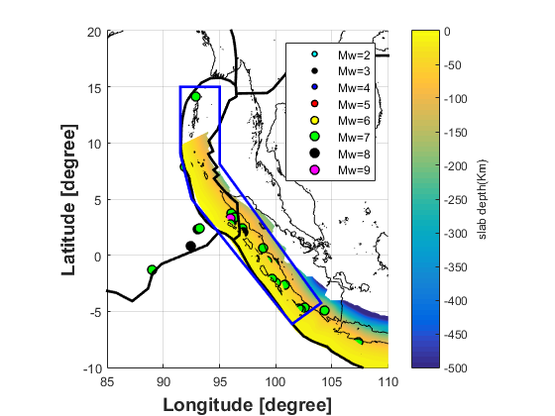
Spatial selections
(B)
(A)
(C)
Spatial selections for (A). Indonesia (B). Chile (C). Japan

Slide 9
Inputs for ETAS parameter estimations
 | Indonesia | Chile | Japan
Catalogue | ANSS | ANSS | JMA
M_{cut} | 4.7 | 4.7 | 4.7
Data window | 1970,1,1-2015,12,31 | 1970,1,1-2015,12,31 | 1970,1,1-2015,12,31

Slide 10
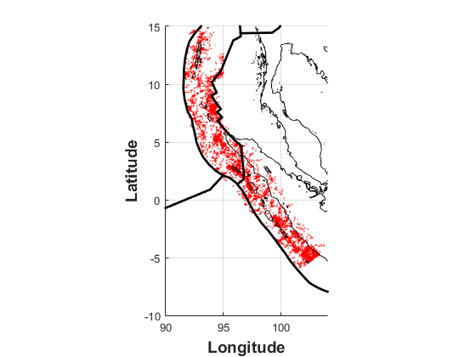
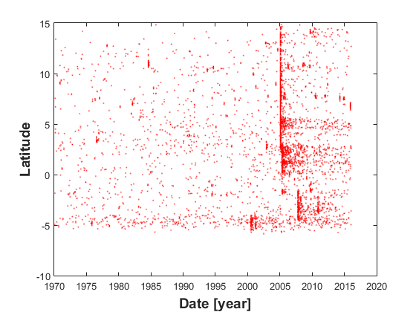
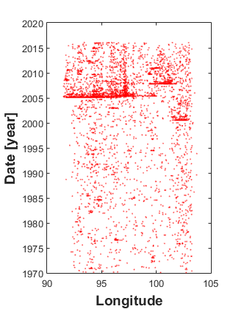
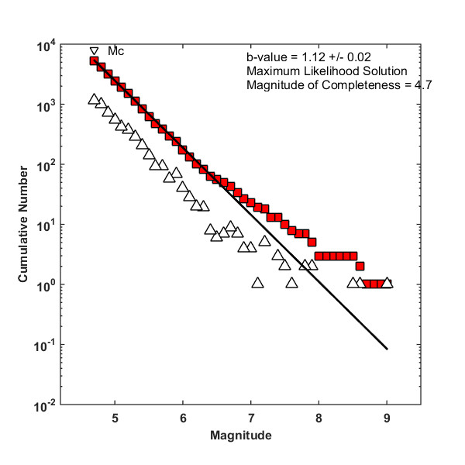
Indonesia
(A). Plot of earthquake epicentres from 1970-2015 for Indonesia (B). A space-time plot of latitude against time (C). A space-time plot of latitude against time (D). Frequency-magnitude distributions

Slide 11
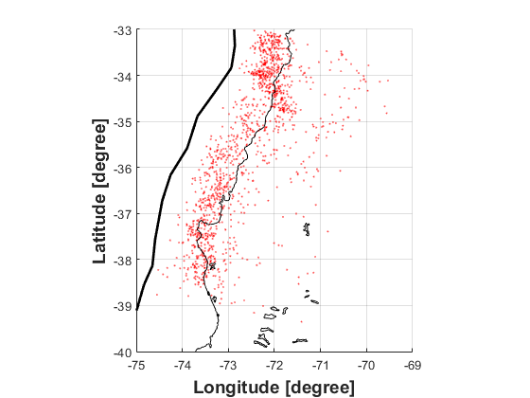
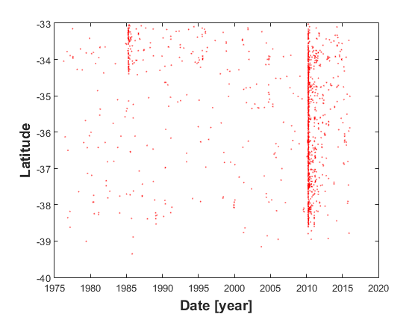
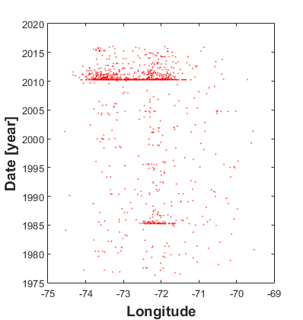
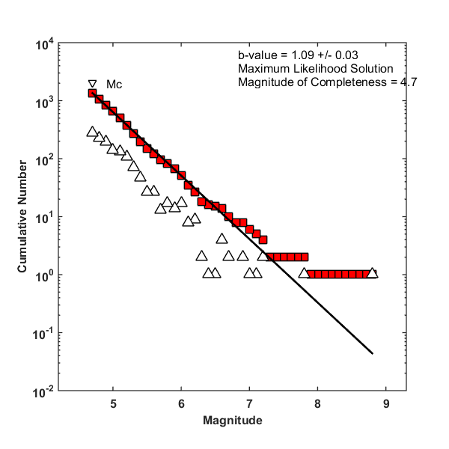
Chile
(A). Plot of earthquake epicentres from 1970-2015 for Chile (B). A space-time plot of latitude against time (C). A space-time plot of latitude against time (D). Frequency-magnitude distributions

Slide 12
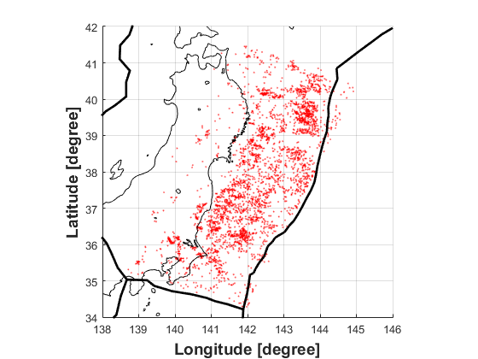
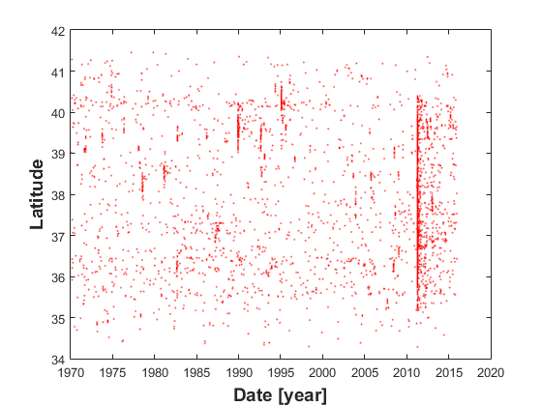
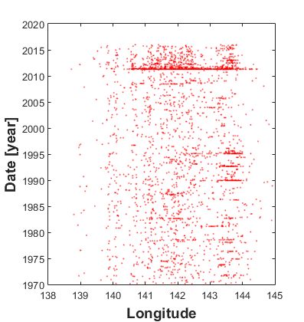
Japan
(A). Plot of earthquake epicentres from 1970-2015 for Japan (B). A space-time plot of latitude against time (C). A space-time plot of latitude against time (D). Frequency-magnitude distributions

Slide 13
The ETAS parameter results
 | K₀ | α (M⁻¹) | c (day) | p | γ (M⁻¹) | d (km²) | q | μ
Indonesia | 0.69 | 1.20 | 0.015 | 1.08 | 1.09 | 57.71 | 1.74 | 1.02
Chile | 0.46 | 1.48 | 0.031 | 1.13 | 1.02 | 161.69 | 2.11 | 1.04
Japan | 0.20 | 1.72 | 0.02 | 1.17 | 1.65 | 13.99 | 2.02 | 1.03
The ETAS simulation inputs
Background events |  | Chile | Japan
 | Time | 2010-02-27 | 2011-03-09 | 2011-03-11
 | Epicentres | 72.90°W,36.12°S | 143.28°E,38.33°N | 142.86°E,38.10°N
 | Magnitudes | M 8.8 | M 7.3 | M 9
Simulation start time |  | 2010-02-27 | 2011-03-09
Number of simulated days |  | 100 | 100
Number of simulations |  | 1000 | 1000
M₀ |  | 5 | 5

Slide 14
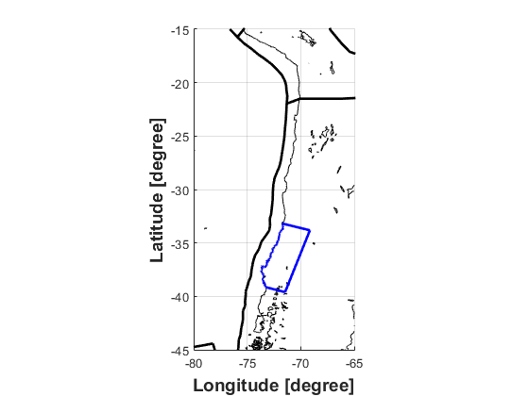
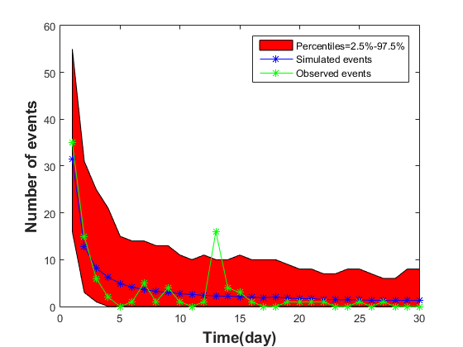
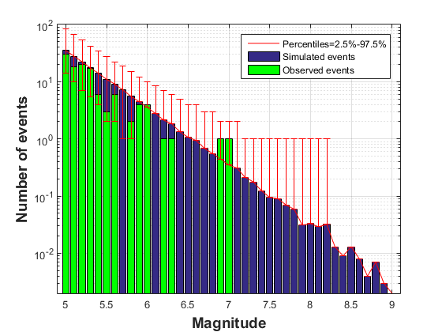
Simulation-Chile
(A)
(B)
(C)
(A) A defined onshore region for Chile. (B) Daily number of observed and simulated earthquakes in onshore region, Chile (C) the comparison of frequency-magnitude distribution between observed and simulated events in onshore region, Chile.

Slide 15
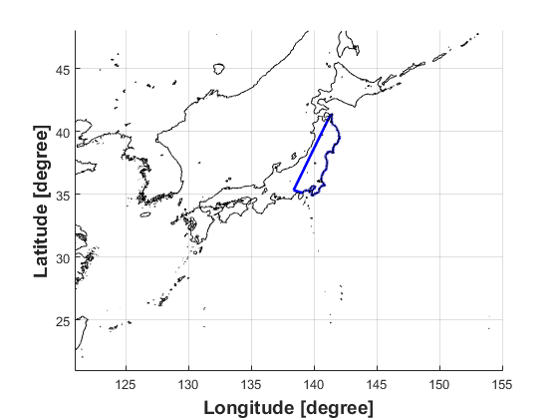
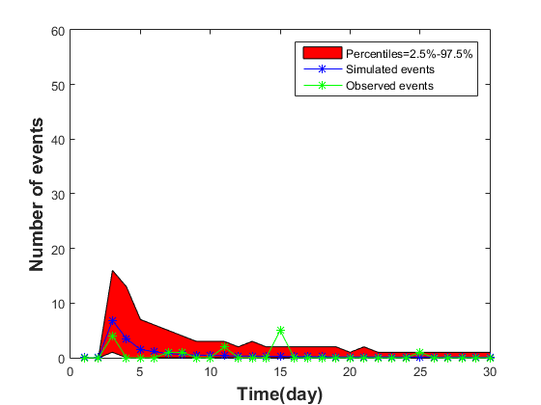
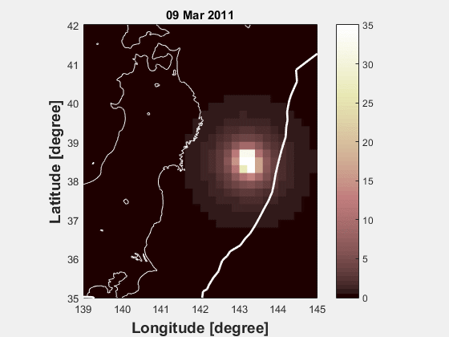
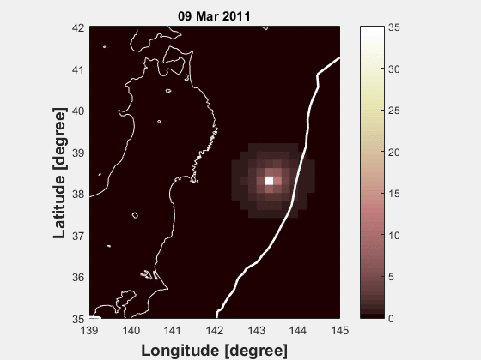
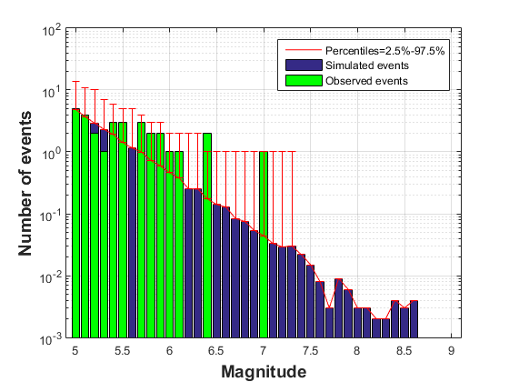
Simulation-Japan
(A)
(B)
Observed spatial daily rates Simulated spatial daily rates
(C)
(A). A defined onshore region for Japan. (B). Daily number of observed and simulated earthquakes in onshore region, Japan (C). the comparison of frequency-magnitude distribution between observed and simulated events in onshore region, Japan.

Slide 16
Conclusion
The ETAS model can capture the number of triggered aftershocks (M≥5) in a short time period for onshore regions given a megathrust subduction earthquake just occurred.
The series of M8s and M9 in Indonesia need to be considered separately to fit into the ETAS model.

