Slide 1
SEISMICITY (M>3.0) IN THE PERIOD 2002-2014
AND ACTIVE TECTONICS IN THE GULF OF CALIFORNIA, MEXICO
Raúl R. Castro¹, Joann Stock² , Egill Hauksson² and Robert Clayton²
¹CICESE, División Ciencias de la Tierra, Departamento de Sismología, Ensenada, Baja California, 22860 México, raul@cicese.mx
²CALTECH, Seismological Laboratory, Pasadena, California, USA

Slide 2
Tectonic Setting
TSSP: Transpeninsular Strike-Slip Province
SCP: Stable Central Peninsula
GEP: Gulf Extensional Province
GP: Guadalupe oceanic Plate
MP: Magdalena oceanic Plate
SMF: San Miguel Fault
ABF: Agua Blanca Fault
SBF: San Benito Fault
TAF: Tosco-Abreojos Fault
Obrebski and Castro (2008)

Slide 3
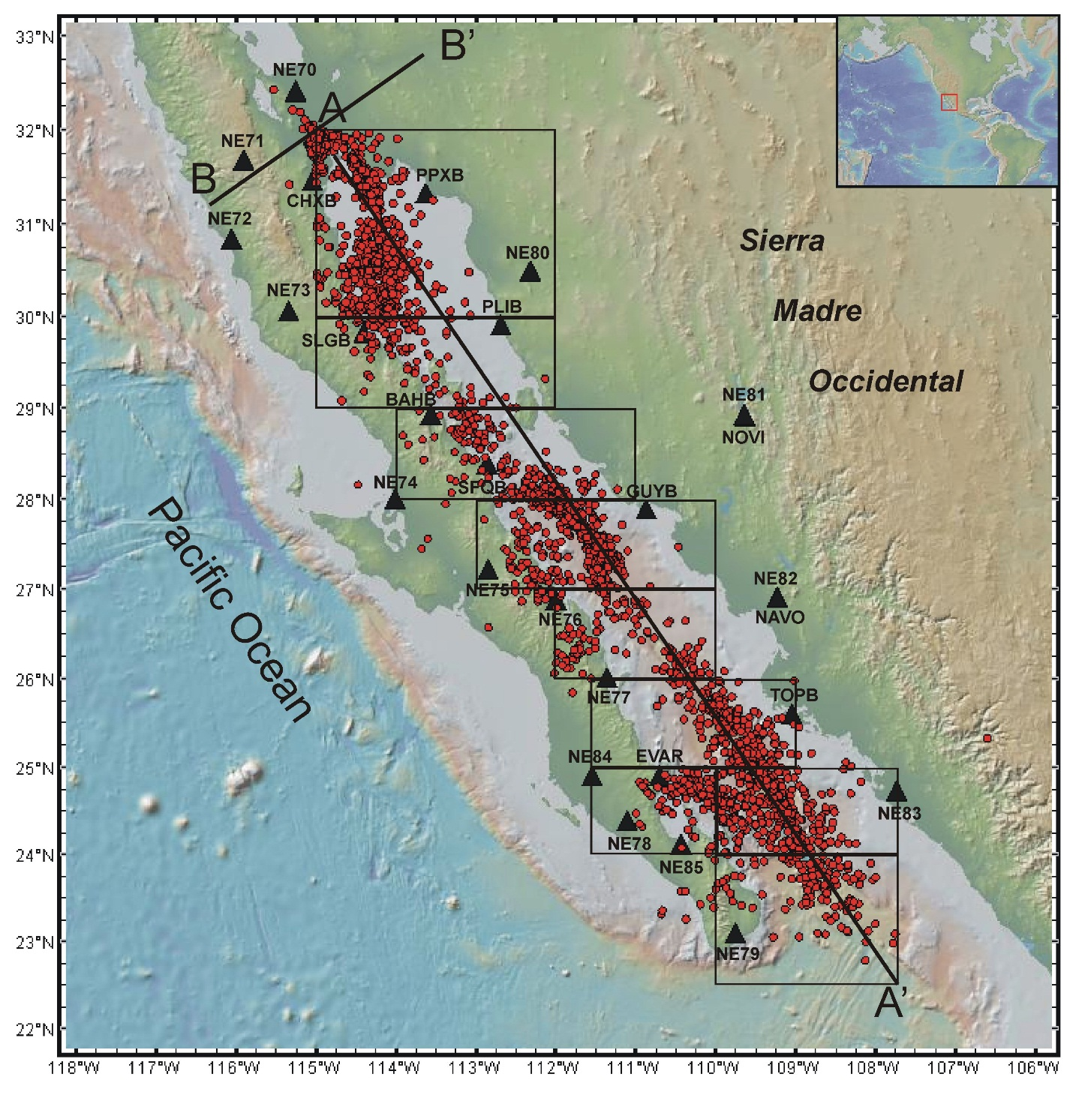
Epicenters from the
ISC Catalog
From 2002-04-01 to 2014-12-31.
The triangles are the locations of the broadband seismic stations from the NARS-Baja (NE70 to NE83) and RESBAN arrays.
2850 earthquakes
Other catalogs:
Hauksson-Yang-Shearer (2011)
Sumy et al. (2013)

Slide 4
Minimum Magnitude of Completeness (Mc)
and b value of the ISC Catalog
The cumulative frequency (triangles) and non-cumulative frequency (circles) from events in four regions of the GoC are displayed.
Upper frames correspond to the northern Gulf (latitudes 30°-32°N and 28°-30°N) and bottom frames to the southern GoC (latitudes 26°-28°N and 23°-26°N).

Slide 5
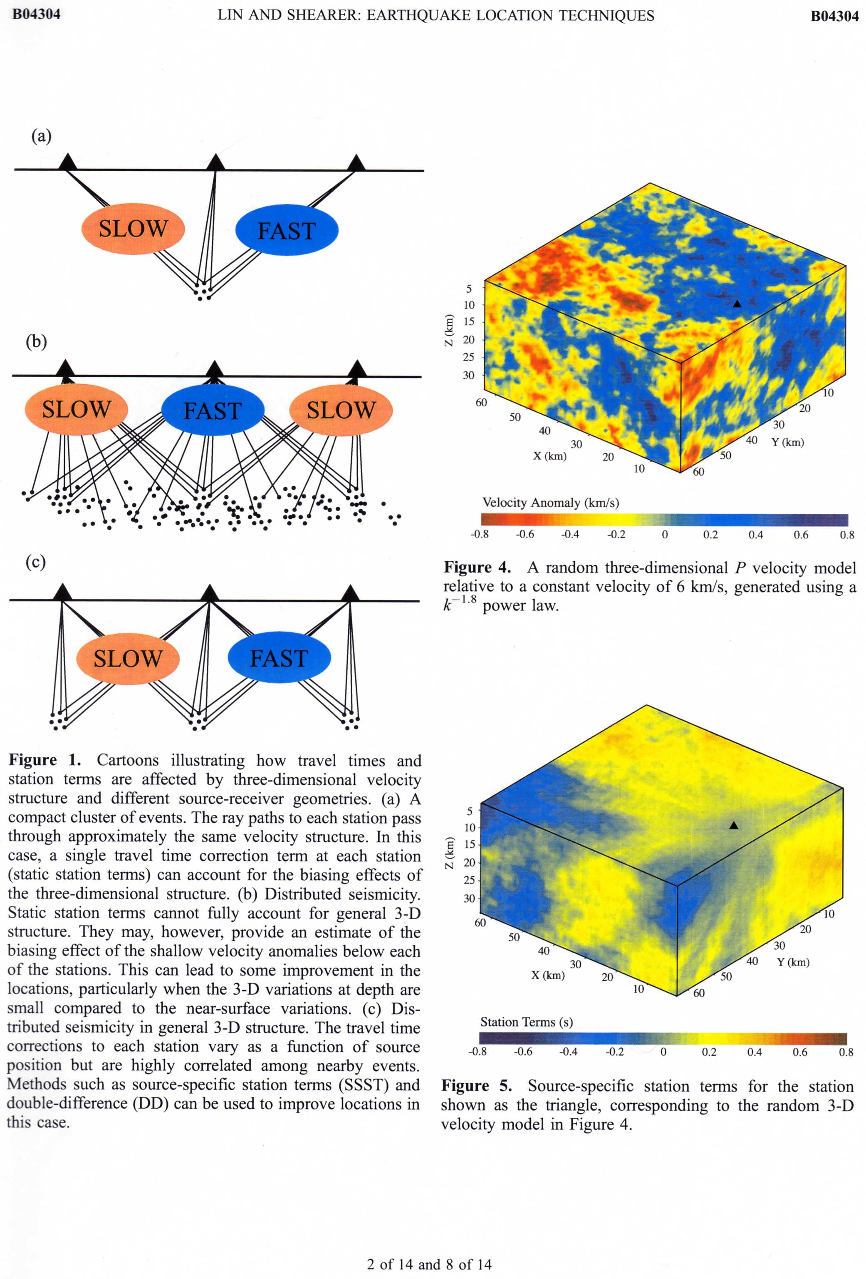
Methods
Source-specific station term Method (SSST)
(Richards-Dinger and Shearer, 2000)
Static station terms (ST) can account for effects of 3D structure.
ST=mean of residuals at each station from all events
(b) Distributed seismicity
(c) Clusters of events
Lin and Shearer (2005)
Shrinking box SSST method
The hypoDD Algorithm
(Waldhauser and Ellsworth, 2000)
Solves for hypocentral separations in a least-squares sense.
Minimizes the differential travel times between pairs of nearby events recorded at common stations
Remove the bias due to velocity model inaccuracies

Slide 6
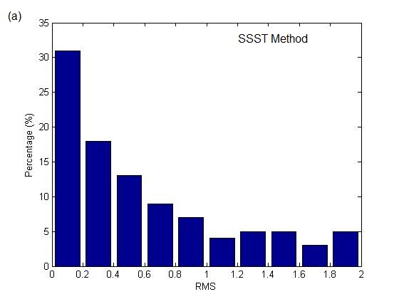
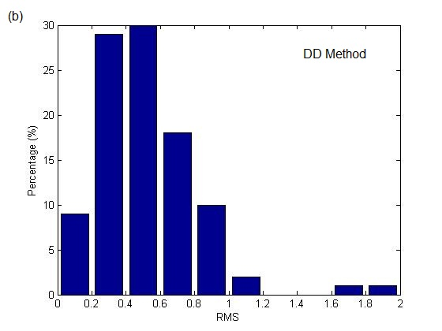
Root Mean Squares (RMS) of Hypocenter Location Error
(a)
(b)
Root Mean Squares (RMS) of hypocenter location error versus the percentage of earthquakes located.
Using the Source Specific Station Term (SSST) method (Lin and Shearer, 2005).
With the Double-Difference method (Waldhauser and Ellsworth, 2000).

Slide 7
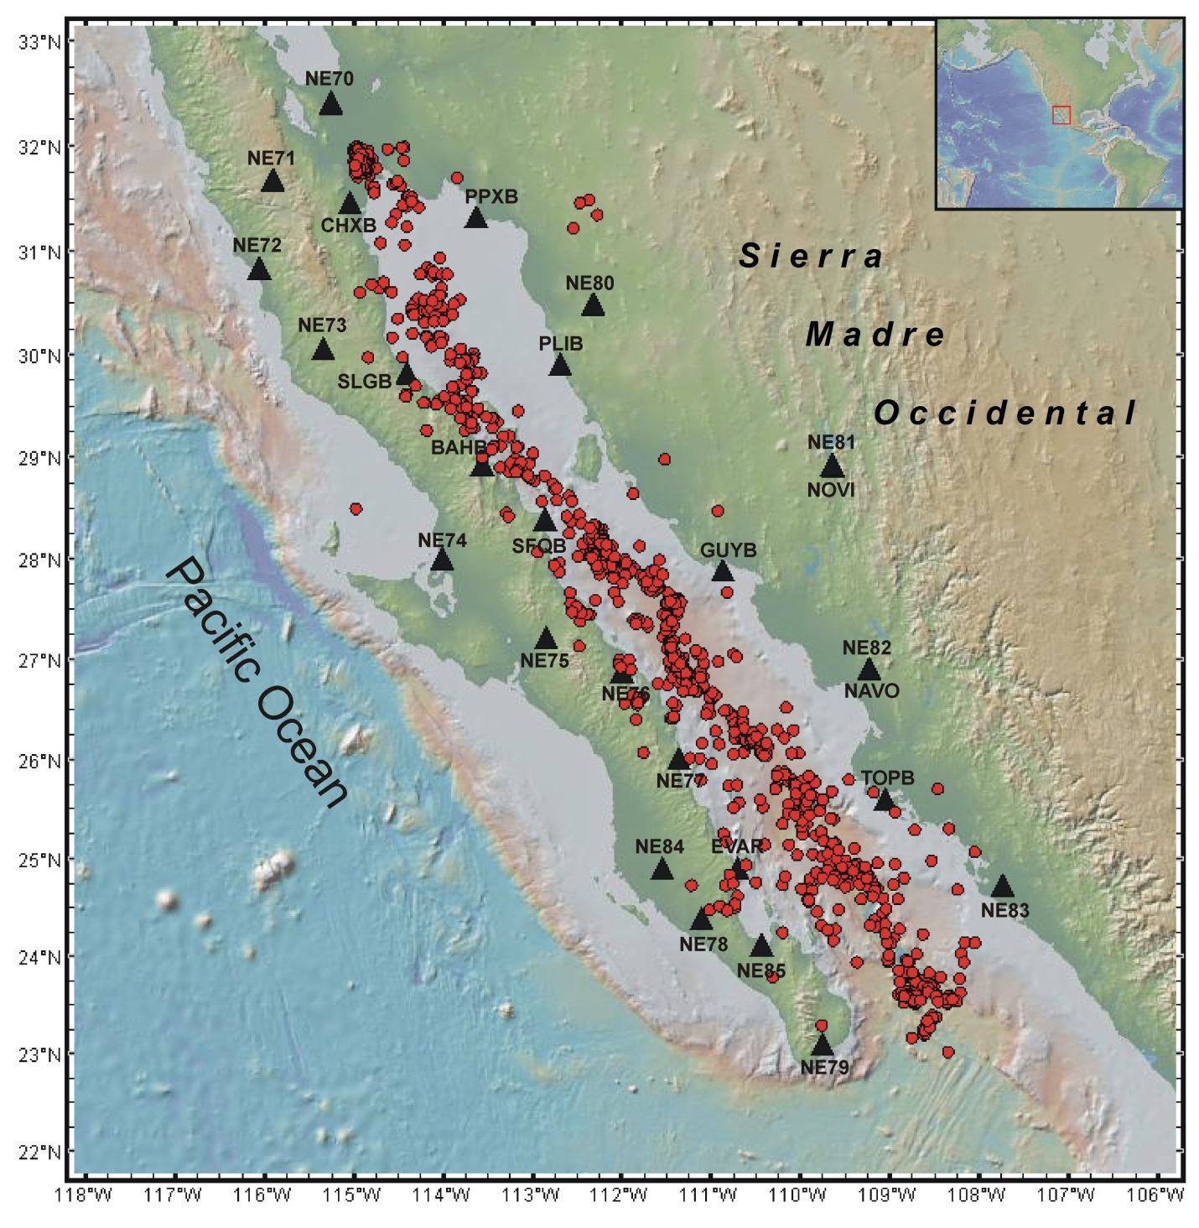
Relocated
Epicenters
Crustal thickness in the peninsula varies from 27-20 km with a maximum of ~42 km.
The topography and bathymetry are from GeoMap App.

Slide 8
Minimum Magnitude of Completeness (Mc) and b-value
of Relocated Earthquakes
For the ISC catalog:
0.86 < b < 1.14
Mc=3.5-3.6
Gulf of California region between 2002 and 2014. The cumulative frequency (triangles) and non-cumulative frequency (circles).

Slide 9
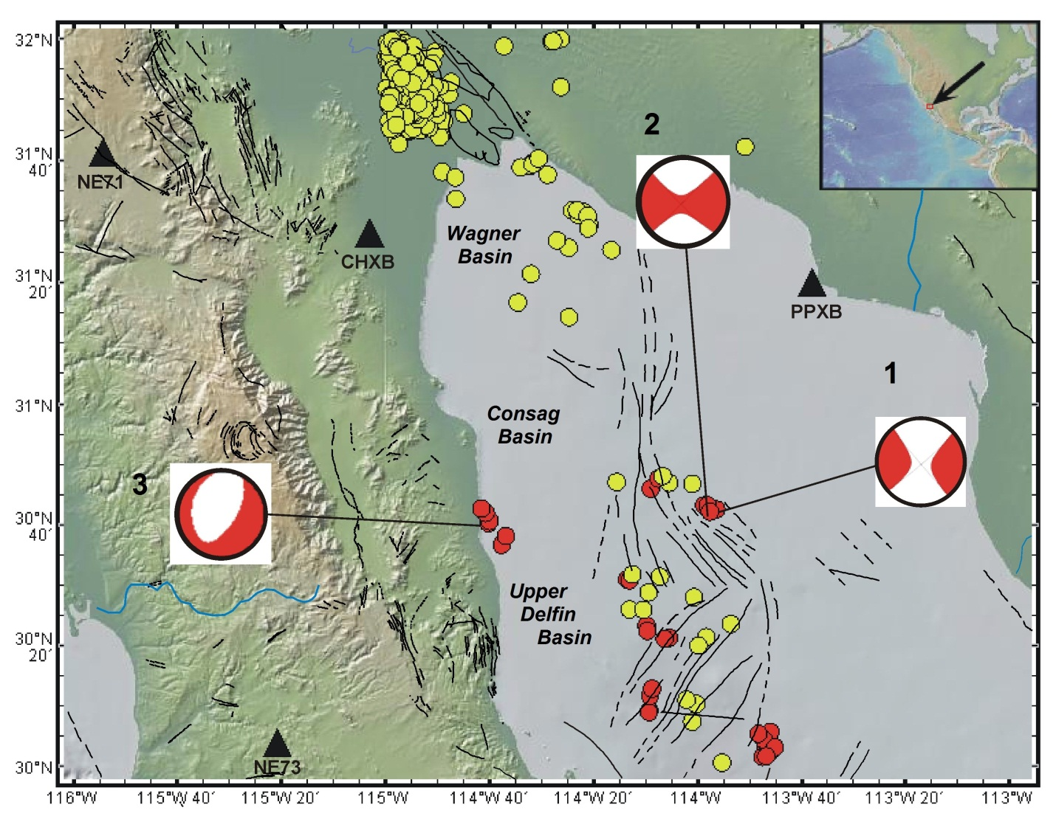
Epicenters Relocated in the Northernmost Zone of the GoC
Period 2002-2014
The red circles are earthquakes relocated with hypoDD (Waldhauser and Ellsworth, 2000) and the yellow circles are events from the 2011-Hauksson-Yang-Shearer, Waveform Relocated Earthquake Catalog for Southern California (Hauksson et al., 2012; Lin et al., 2007). The focal mechanisms were taken from the GCMT catalog and the faults from the Generic Mapping Tools (Wessel and Smith, 1998).The topography and bathymetry are from GeoMap App (Ryan et al., 2009)

Slide 10
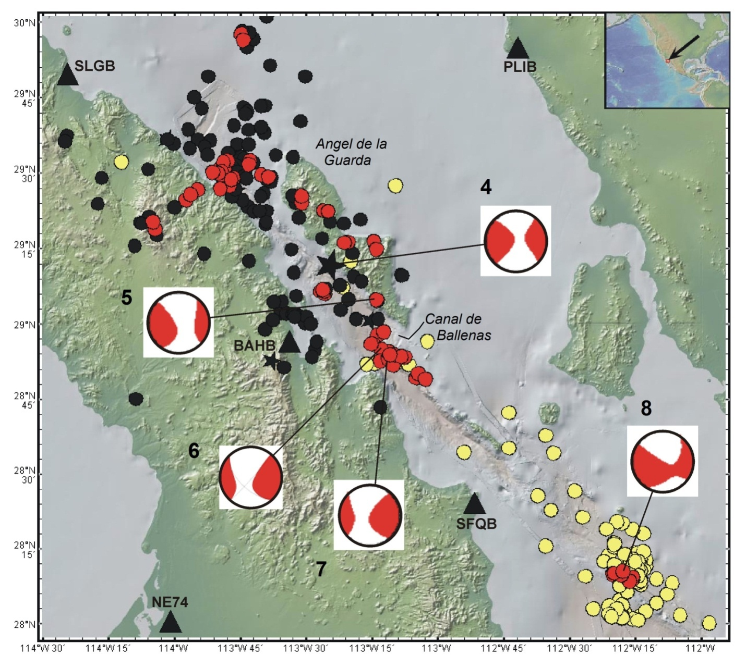
Relocated Earthquakes in the North-Central Gulf
The red circles are earthquakes relocated with hypoDD (Waldhauser and Ellsworth, 2000) and the yellow circles earthquakes relocated by Sumy et al., (2013) using the OBS of the SCOOBA experiment. Epicenters on black were located by Castro et al. (2011b) and the focal mechanisms were taken from the GCMT catalog. The topography and bathymetry are from GeoMap App.
SCPP

Slide 11
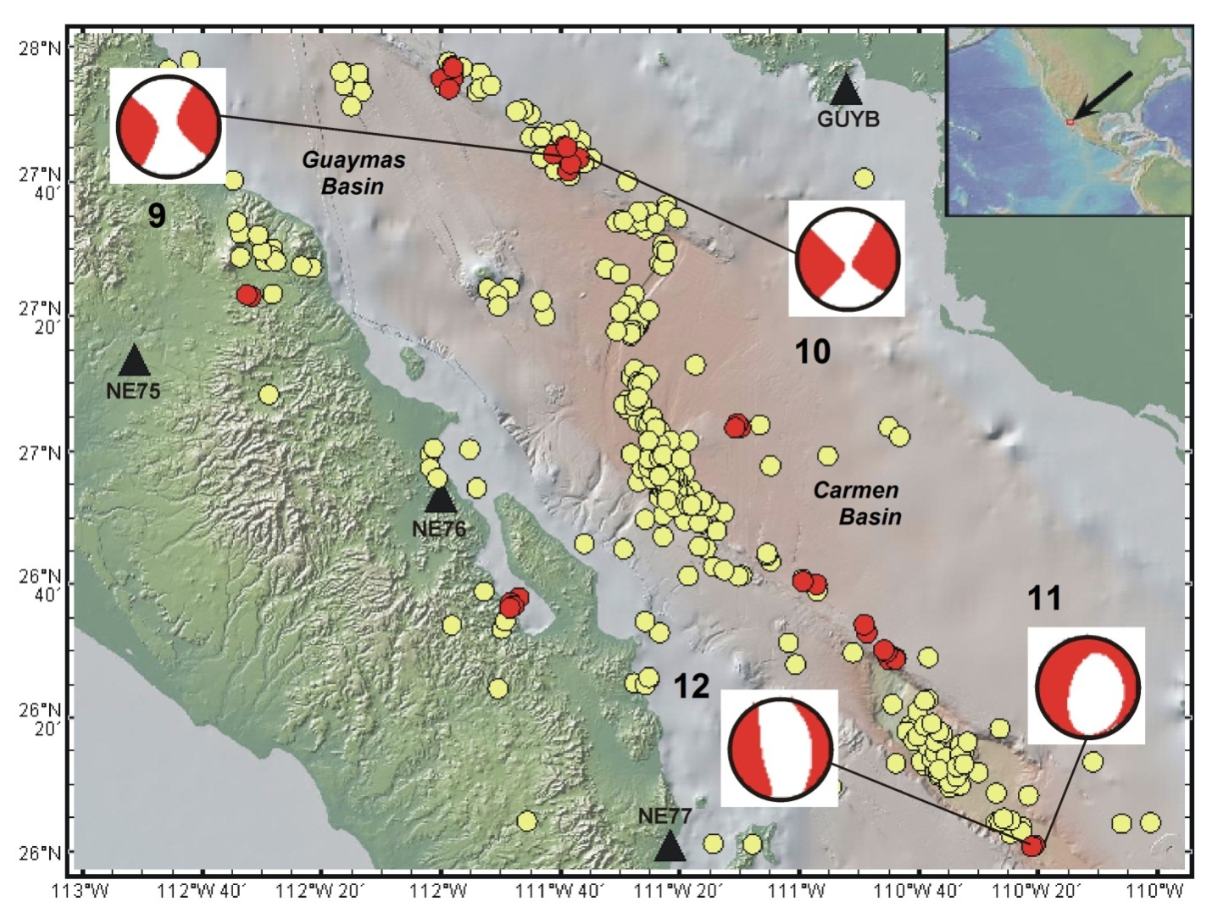
Epicenters Relocated in the South-Central GoC, for the Period 2002-2014
Tres Virgenes
The red circles are earthquakes relocated with hypoDD (Waldhauser and Ellsworth, 2000) and the yellow circles are events located by Sumy et al. (2013). The focal mechanisms were taken from the GCMT catalog. The topography and bathymetry are from GeoMap App.

Slide 12
South-Central Gulf of California
Carmen basin
East-west profiles showing the average shear wave velocities (top), modified from Di Luccio et al., (2014), and hypocenters relocated in this study between 26.9°N and 26.7°N.

Slide 13
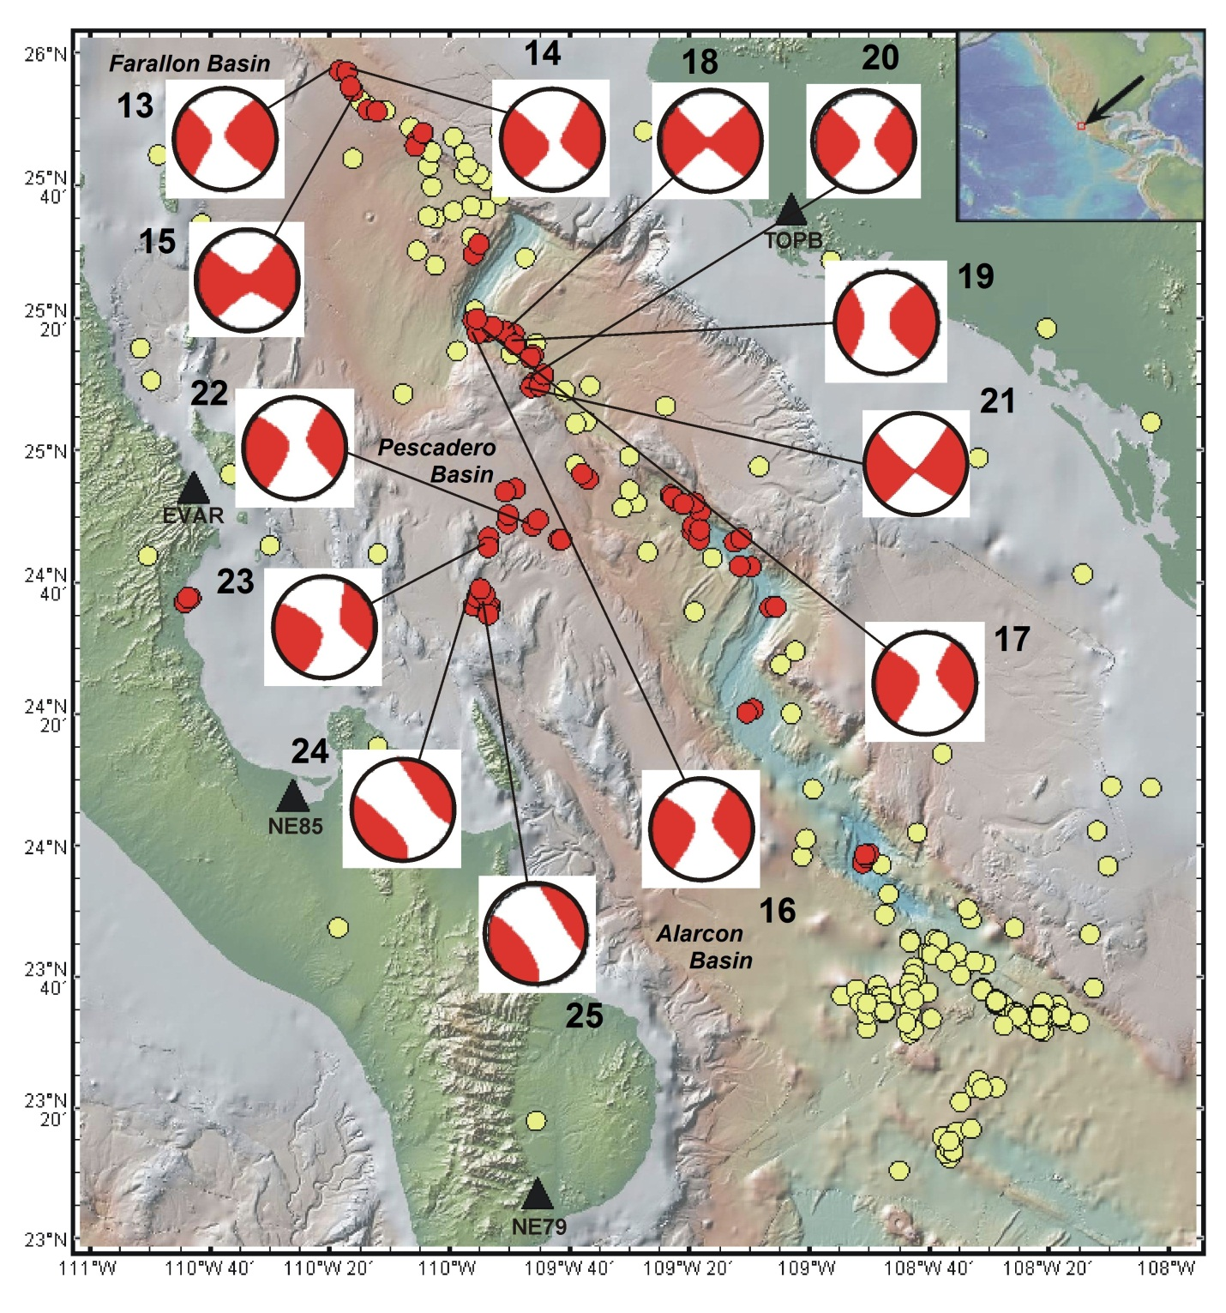
Epicenters Relocated in the Southern GoC,
Period 2002-2014
The Alarcon rift extended ~ 350km
The red circles are earthquakes relocated with hypoDD (Waldhauser and Ellsworth, 2000) and the yellow circles are events located by Sumy et al. (2013).The focal mechanisms were taken from the GCMT catalog.The topography and bathymetry are from GeoMap App.

Slide 14
Southern GoC
Farallon basin
East-west profiles showing the average shear wave velocities (top), modified from Di Luccioet al., (2014), and hypocenters relocated in this study between 25.7°N and 25.9°N.

Slide 15
CONCLUSIONS
The catalog of relocate earthquakes permitted to identify regions of active tectonics within the Pacific-North America plate boundary.
Stress transfer outside the plate boundary, caused by geometrical irregularities and/or reactivation of preexisting faults generates clustered swarms of intraplate earthquakes.
We observed seismicity that occurs in the Stable Central Peninsular Province, despite the fact that significant active deformation has NOT been identified in this province.

Slide 16
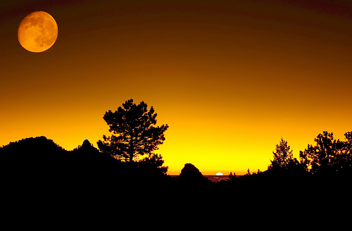
THANK YOU !

Slide 18
P wave velocity models used
The solid line is the model determined by Gonzalez-Fernandez et al.,(2005), the dotted line is the model of Lopez-Pineda et al., (2007)and the dashed line the velocity model derived by Sumy et al. (2013).

Slide 19
Cross sections of relocated hypocenters with hypoDD
The left frame shows the distribution of the earthquakes projected on a plane parallel to the GoC axis (NW-SE direction) with the origin at the northernmost point of the gulf (31.786°N,114.750°W). The right frame displays the hypocenters projected on a plane perpendicular to the axis of the gulf, in the SW-NE direction. The vertical exaggeration is 60 times the horizontal scale.

